Slide 1
PCB DESIGN
Submitted by:
Mohammed Abdul Muqeeth C0751945
Group #5

Slide 2
AGENDA
Introduction to the project.
Introduction to the software used.
Initializing a project.
Procedure involved in designing PCB.
Transmitter side PCB Design.
Receiver side PCB Design.
Routing options.
Gerber File.
Conclusion and references.

Slide 3
INTROCTION TO PROJECT
Hand Gestured Keyboard using Gyroscope sensor.
We are using a combination of BBB and Arduino UNO.
ESP8266 Wi-Fi module is being used to store the letters on cloud infrastructure.
The letters are also displayed on the LCD.

Slide 4
INTRODUCTION TO EasyEDA
Web based tool to Design and the simulate the Schematics and PCBs.
Allows user contribution foot prints.
Has huge collection of components and footprints.
Features Hot key settings.
Can generate BOM and Gerber files.
Can view the Design in 2D and 3D formats.

Slide 5
INITIALIZING A PROJECT
Sign
Sign-up on http://www.easyeda.com
Click on
Click on “File” to create a new project.
Input
Input the title and short description and then save the project.
Click on
Double click on “Sheet” under project title on the left-hand side to get started with designing the schematic and PCB.

Slide 6
PROCEDURE INVOLVED IN DESIGNING PCB
Select, place and wire the components to design a schematic diagram of the project.
Once the Schematic is designed, save it and click on “Convert to PCB” option in the “Design” menu.
Ignore the warning that pops up for unfinished nets and keep going.
Apply our requirements.
Route using Track tool.
Note: Make sure to select the components with valid footprints.

Slide 7
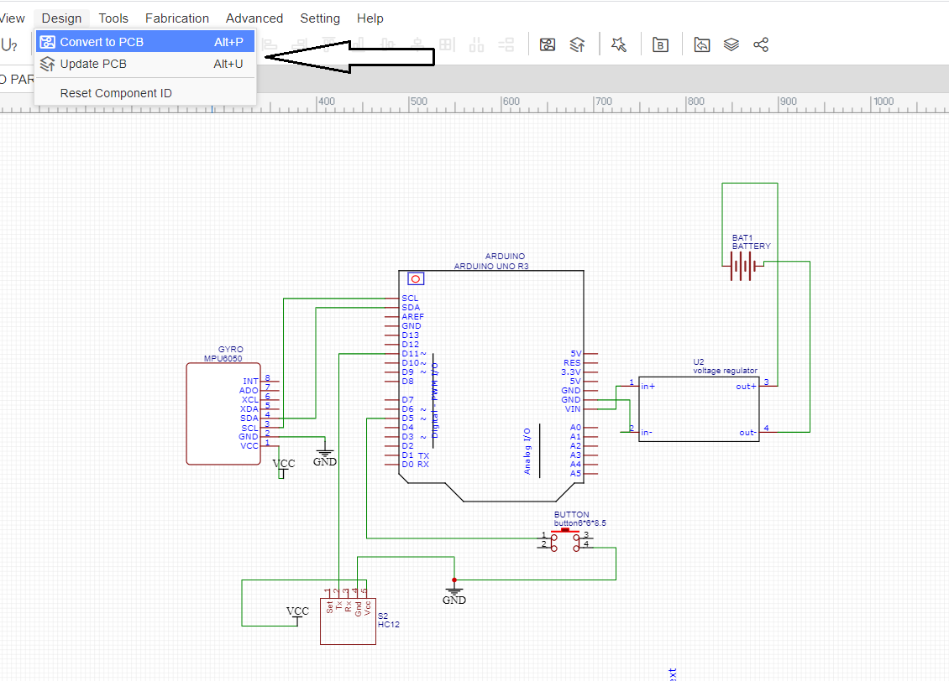
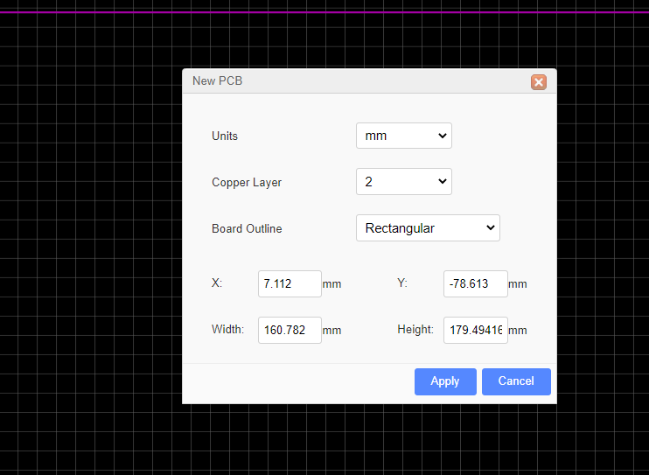
PROCEDURE INVOLVED IN DESIGNING PCB

Slide 8
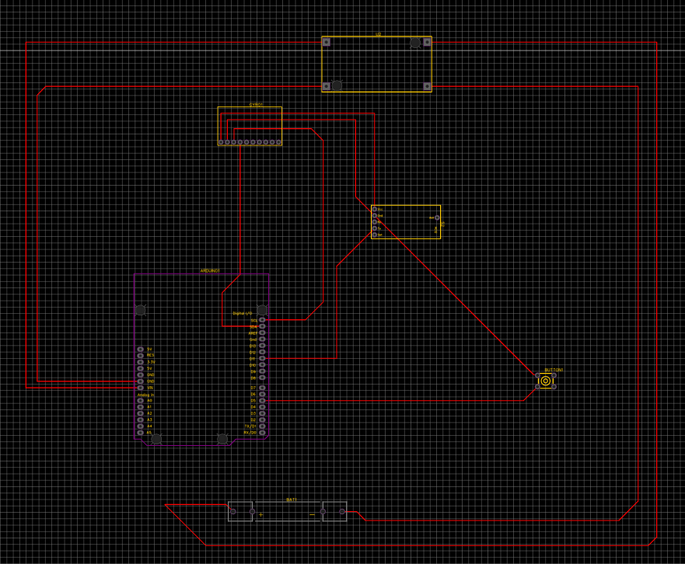
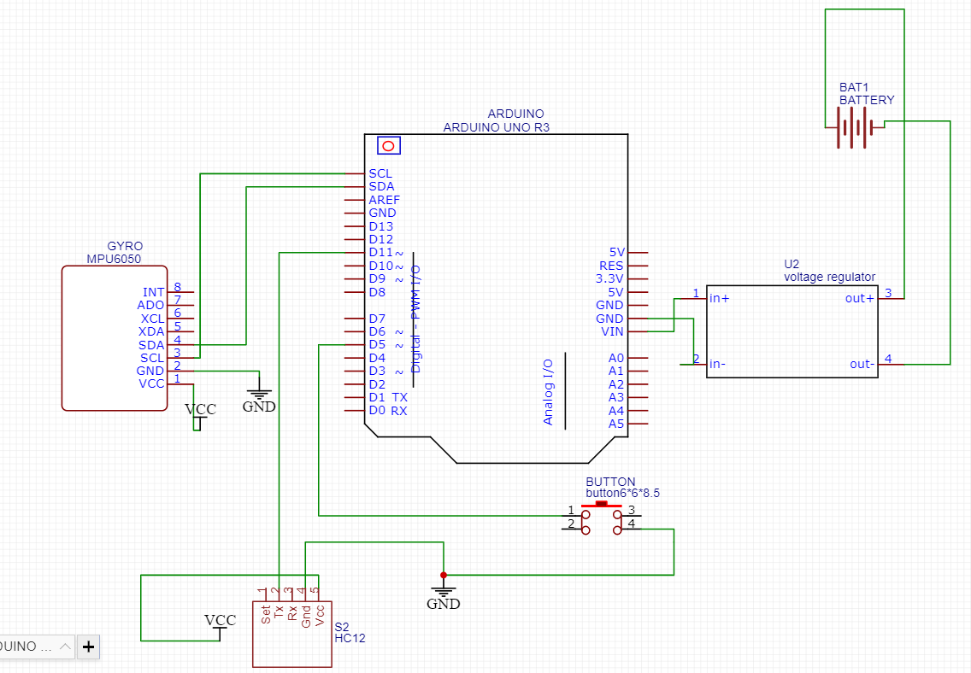
TRANSMITTER SIDE PCB DESIGN

Slide 9
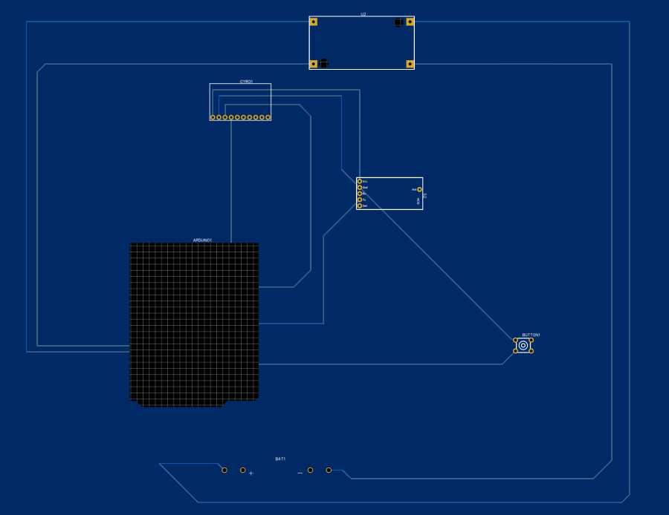
TRANSMITTER SIDE PCB - 2D VIEW

Slide 10
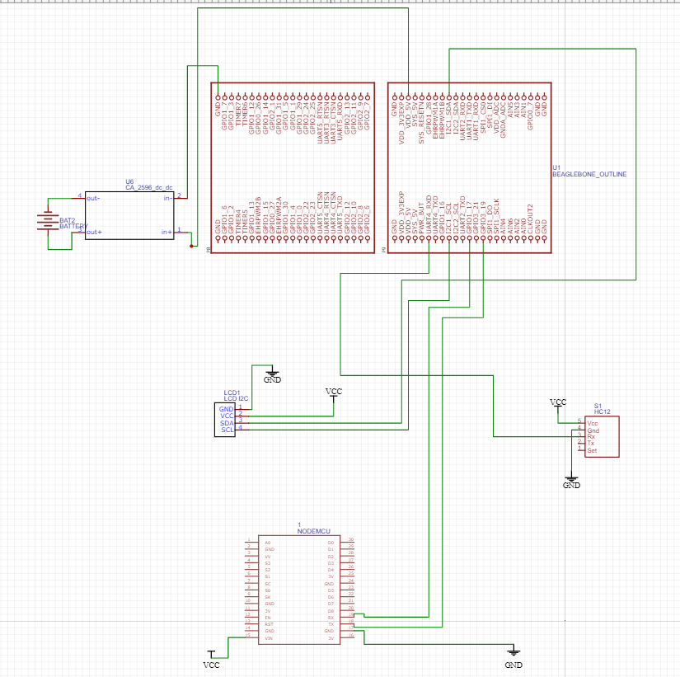
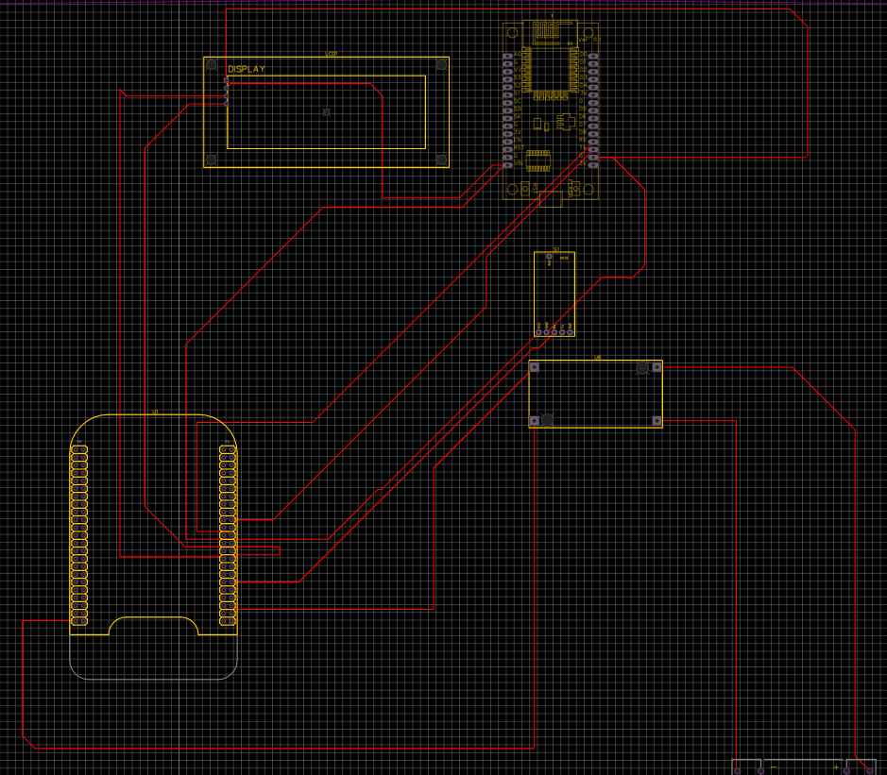
RECEIVER SIDE PCB DESIGN

Slide 11
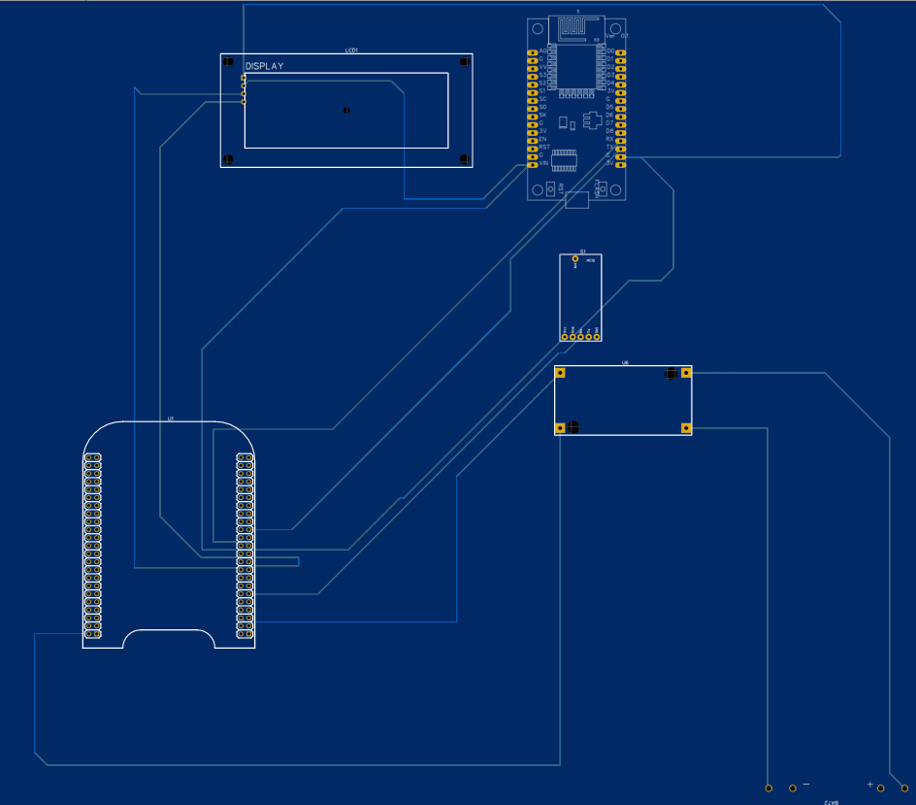
RECEIVER SIDE PCB - 2D VIEW

Slide 12
ROUTING OPTIONS
AUTO ROUTER : The software automatically lays the route for the component's connections.
DIFFERENTIAL PAIR ROUTING : This is nothing but manual routing. In this method, we select “Track” tool from the PCB Tools and lay the route among all the member components.
Auto router drawback: At times, the software cannot associate a route automatically and we need to check for any incomplete routing and perform manually.

Slide 13
GERBER FILE
Gerber files contain information on each physical board layer of PCB Design.
Elements like Copper traces, vias, pads, solder mask are all represented by a flash or draw code and defined by a series of Vector coordinates.
To generate a Gerber file, Click on “PCB fabrication file” on the top.
This generated Gerber file is used to place an order for PCB with any PCB Manufacturing company as it contains all the necessary info.
We can place an order for PCB within EasyEDA using this Gerber as it is tied up with JLCPCB company.

Slide 14
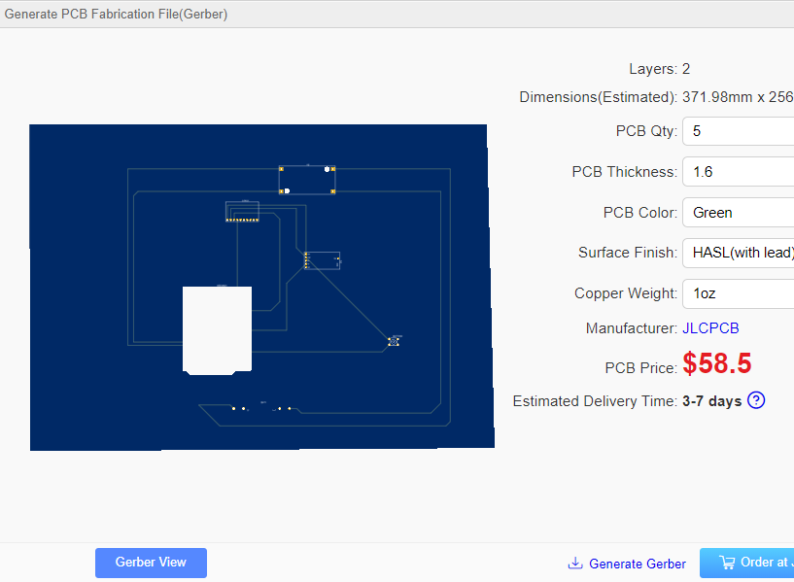
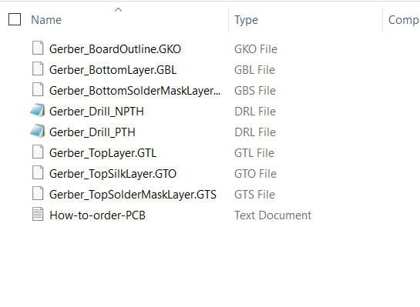
GERBER FILE CREATION

Slide 15
CONCLUSION
In this session, we have seen the process of Designing the PCB for any project and order the designed PCB using the Gerber file.

Slide 16
REFERENCES
An Easier and Powerful Online PCB Design Tool. (n.d.). Retrieved December 06, 2020, fromhttps://docs.easyeda.com/en/PCB/Gerber-Generate/index.html
Gerber Files Explained: Understanding Their Role in PCB Manufacturing. Retrieved December 06, 2020, fromhttps://www.vse.com/blog/2019/10/29/gerber-files-explained-understanding-their-role-in-pcb-manufacturing/
How to Design a PCB Layout. (2017, April 11). Retrieved December 06, 2020, fromhttps://www.circuitbasics.com/make-custom-pcb/
Top 10 PCB Routing Tips for Beginners: EAGLE: Blog. (2017, May 10). Retrieved December 06, 2020, from https://www.autodesk.com/products/eagle/blog/top-10-pcb-routing-tips-beginners/

